Slide 1
NON VERBAL COMMUNICATION AND LISTENING

Slide 2
01
TABLE OF CONTENTS
02
03
04
05
Non-verbal Communication
Describes non-verbal communication and its types.
Codes and functions of non verbal communication
Describes the 3 codes and 4 functions.
Listening
Describes listening and its types
Barriers OF LISTENING
Lists different barriers of listening
WAYS TO IMPROVE LISTENING
Ways to improve listening are discussed here.

Slide 3
01.
NON VERBAL COMMUNICATION and its types
Nimrah Altaf Adam
SESE-19077

Slide 4

What IS NON VERBAL COMMUNICATION ?(1 of 2)
Non-verbal communication is when you use your body to express yourself.
The key to success in both personal and professional relationships lies in your ability to communicate well, it’s not the words that you use but your nonverbal cues or “body language” that speak the loudest.

Slide 5
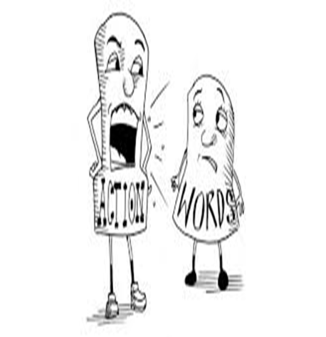
What IS NON VERBAL COMMUNICATION ?(2 of 2)
Whether you’re aware of it or not, when you interact with others, you’re continuously giving and receiving wordless signals..
All of your nonverbal behaviors—the gestures you make, your posture, your tone of voice, how much eye contact you make—send strong messages.

Slide 6





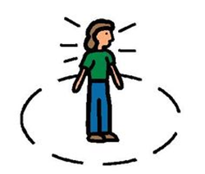
Types OF NONVERBAL COMMUNICATION
FACIAL EXPRESSION
Body Language & Postures
GESTURES
PARALINGUISTICS
Eye Contact
PROXEMICS

Slide 7

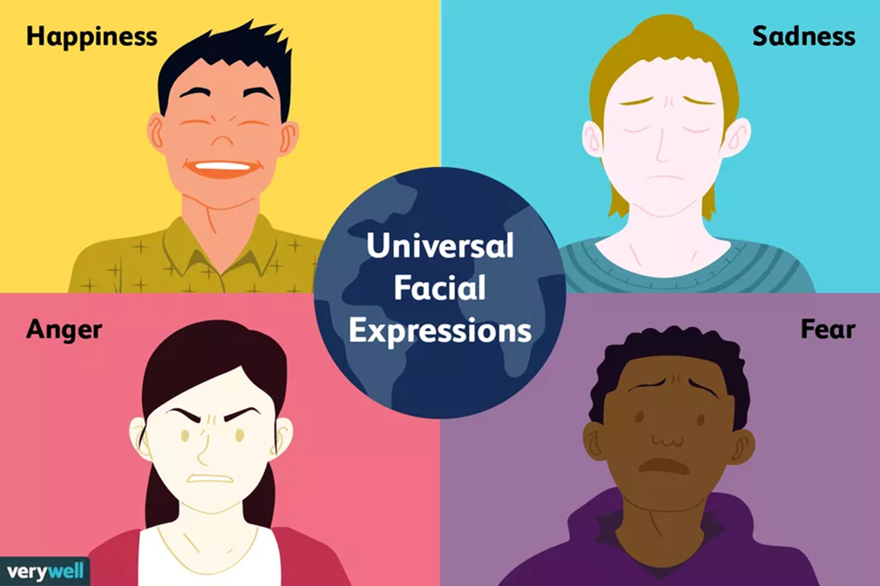
Facial Expressions

Slide 8
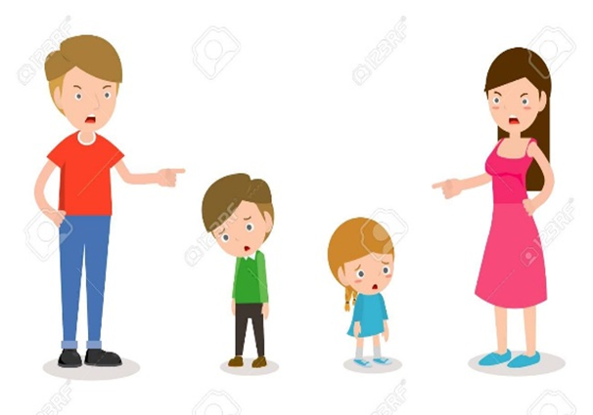
example
On the basis of Our expressions we decide in what mood the other person is and then we react accordingly to the information that is conveyed to us

Slide 9



GESTURES

Slide 10
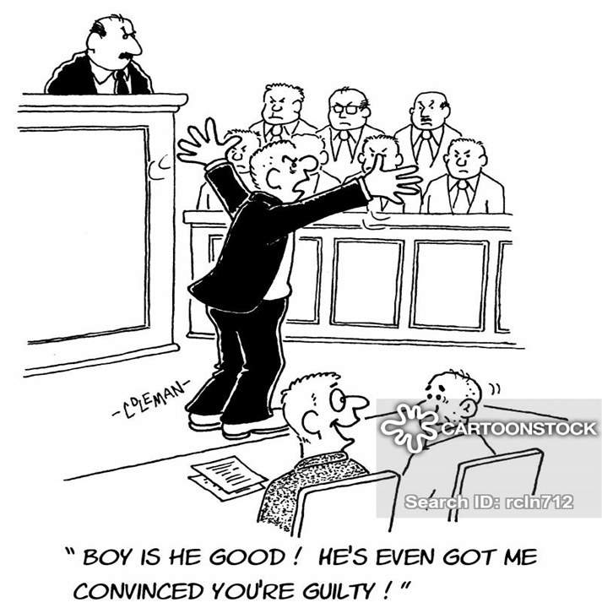
Lawyers in the court are known to utilize different nonverbal signals to attempt to sway juror opinions.

Slide 11



PARALINGUISTICS

Slide 12
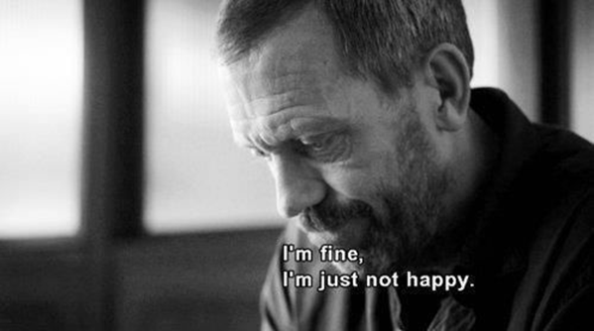

Consider all the different ways in which a sentence can have different meaning by simply changing the tone of your voice.

Slide 13
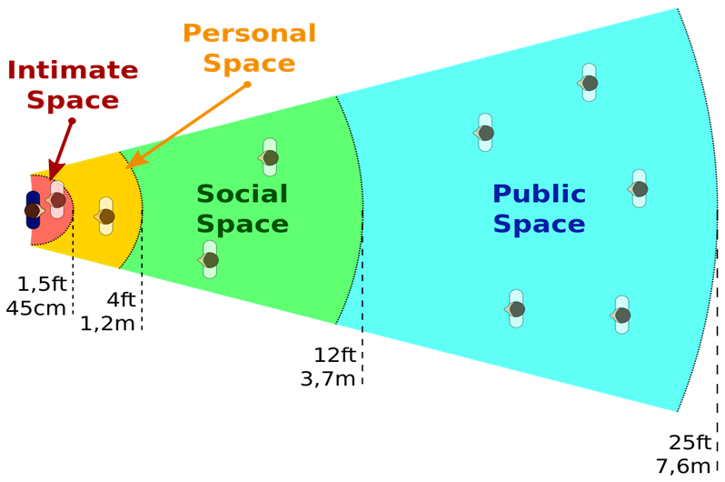
PROXEMICS

Slide 14
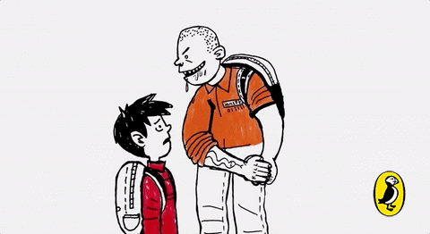
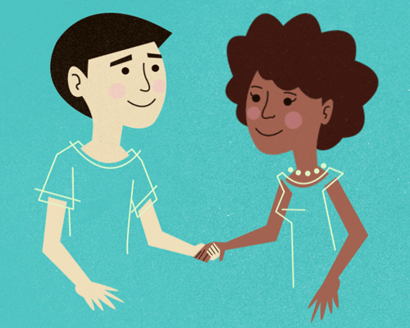
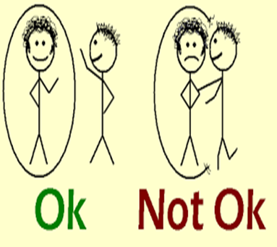
Have you ever felt uncomfortable during a conversation because the other person was standing too close and invading your space? We all have a need for physical space, although that need differs depending on the culture, the situation, and the closeness of the relationship.

Slide 15
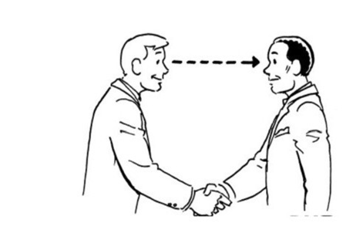
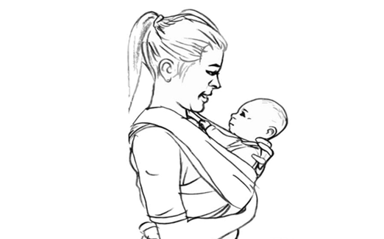
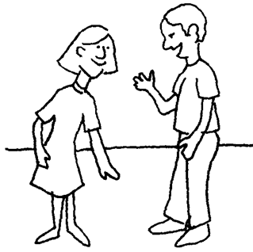
EYE CONTACT

Slide 16
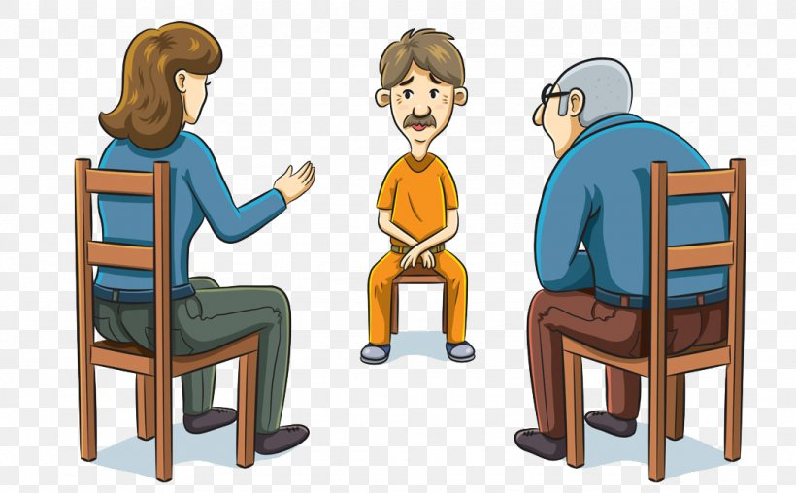
People also utilize eye gaze as a means to determine if someone is being honest.

Slide 17



BODY LANGUAGE & POSTURES

Slide 18

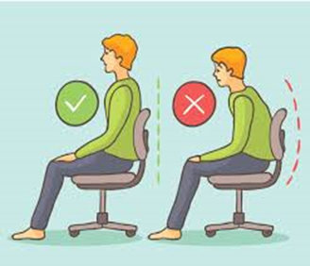



USE OF BODY LANGUAGE AND POSTURES DURING INTERVIEW

Slide 19
02.
TYPES OF NON VERBAL CODES
Presented by: RIDA KALIM
SE-079

Slide 20
What are non verbal codes?
Non verbal codes are meanings derived from other and coded without words
This is usually done when verbal and non verbal messages contradict
Non vebral are trusted more in such situations

Slide 21
3 CODES of non verbal communication
TEMPORAL CODES
PERSON ORIENTED CODES
ENVIRONMENTAL CODES

Slide 22

TEMPORAL CODES
CHRONEMICS
PROXEMICS - SPACE
is the study of how we refer to and perceive time.
Time is a relevant factor of the communication process
Across cultures the value of time may vary
space is often associated with social rank
is an important part of business communication.

Slide 23
PERSON ORIENTED CODES
APPEARANCE
KINESICS
HAPTICS
movement, gesture, posture, facial expression and eyes
We often make judgments about a person’s personality or behavior based on physical characteristics
Social - polite touch
Handshakes
Considering ones personal space

Slide 24
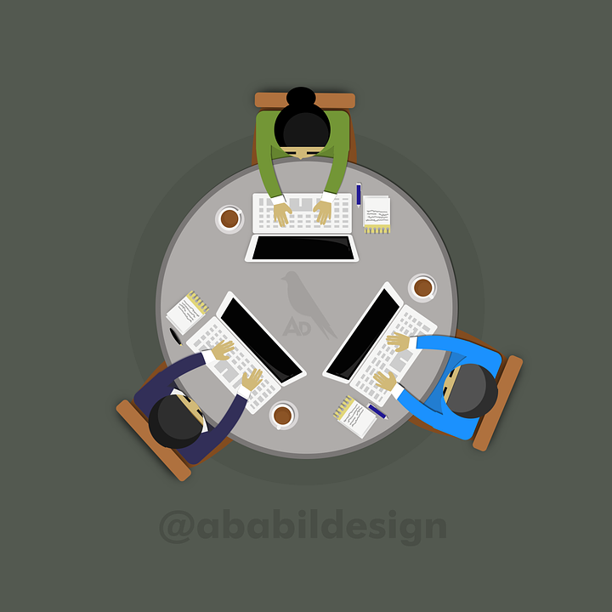

ENVIRONMENTAL CODES
OBJECTS IN THE ENVIRONMENT
VOLUME OF SPACE
ARRANGEMENT

Slide 25
FUNCTIONS OF NON VERBAL COMMUNICATION
REINFORCEMENT
REGULATION
Non verbal cues used to emphasize a verbal message
Non verbal cues used to regulate the flow of the conversation
SUBSTITUTION
MODIFICATION
Non verbal cues used instead of verbal communication
Non verbal cues used to controdict a verbal statement.

Slide 26
Reinforcement modification
A
B
!!!!
The tone of one’s voice
Emphasizing on certain words to give a clear message
Vocal variation
Gestures
A contradiction between the verbal and non verbal cues
nonverbal communication to be more credible than verbal communication

Slide 27
substitution regulation
Using non verbal cues instead of words
Often used to accentuate, emphasize and soften the verbal message
Certain body language or non verbal cues used to regulate the conversation
Using gestures to emphasize that you are done speaking or if the conversation is over

Slide 28
03.
LISTENING
By: FARIYA KHAN
SE-066

Slide 29
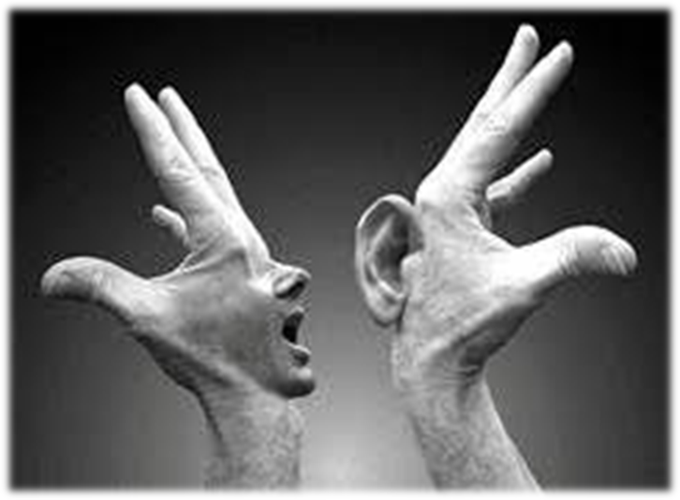
What is listening?
Listening is the ability to accurately receive and interpret messages in the communication process. Listening is key to all effective communication.

Slide 30
01
02
Types of listening
03
04
05
06
07
Appreciative Listening
Emphatic/Therapeutic Listening
Comprehensive/Active Listening
Participatory Listening
Critical /Analytic Listening
Passive Listening
Judgemental Listening

Slide 31
08
09
Types of listening
10
11
12
13
14
Non-Judgemental Listening
Surface Listening
Deep Listening
Selective Listening
False Listening
Content Listening
Biased Listening

Slide 32


01. Appreciative Listening
Listening for enjoyment, pleasure as we listen to music for relaxation or enjoy comedy routine or any entertainment speech.

Slide 33


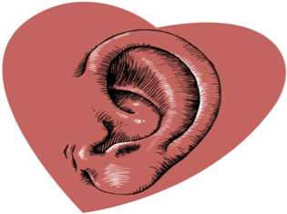
02. Emphatic/Therapeutic Listening
The practice of being attentive and responsive to other, listening to provide emotional support.
Example: a psychiatrist listens to patient or to lend a sympathetic
To listen from heart

Slide 34
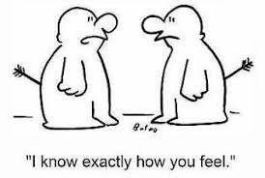

“Sometimes all a person wants is an empathetic ear; all he or she needs is to talk it out. Just offering a listening ear and an understanding heart for his or her suffering can be a big comfort.”
― Roy T. Bennett

Slide 35

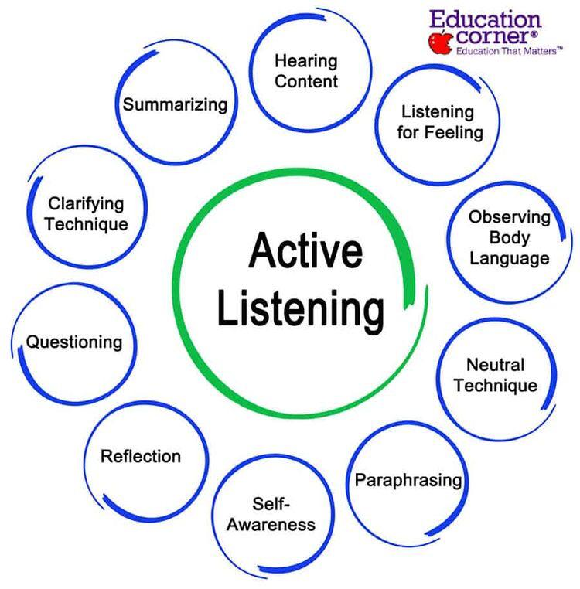
03. Comprehensive/Active Listening
Comprehensive listening involves understanding the thoughts, ideas, and message.

Slide 36

04. Critical /Analytic Listening
Critical listening is listening to evaluate the content of the message. As a critical listener you are listening to all parts of the message, analyzing it, and evaluating what you heard.

Slide 37

05. Participatory Listening
Act physically and mentally like one i.e. participate equal partner with speaker.
For instance: group lessons, discussions, meetings.

Slide 38

06. Passive Listening
A one way communication process. No participation with the speaker i.e. listening without reacting.
For instance: listening to radio, tv etc.

Slide 39


07. Judgemental Listening
Constantly judge while they listen.
Determine whether it's right or wrong.
Ex: media , society.

Slide 40
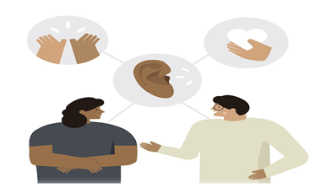

08. Non-Judgemental Listening
Trying to really understand the other person.
Involves understanding exactly what the other person is saying.

Slide 41
Objective listening is to go beyond empathy and measure meaning and feelings against some objective reality Sometimes you have to put your empathic responses aside and listen with objectivity and detachment.
09. Objective Listening

Slide 42
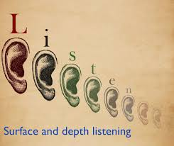
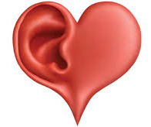
Listening to literal and obvious meaning of words and sentences .
Listening to underlying message about the person feelings , it involves listening, from a deep, receptive, and caring place in oneself .
10. Surface Listening
11. Deep Listening

Slide 43
Listening steps
feedback
Receiving
UnderstandinG
Remembering
evaluating
Steps
01
02
03
05
05

Slide 44
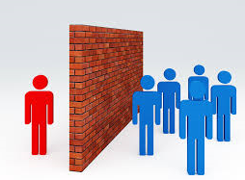
04.
BARRIERS tO
LISTENING
FAsih ur rehman ansari SE-090

Slide 45
Types
01
02
03
04
05
Information Overload
Personal Concerns
Outside Distraction
Prejudice
Rate Of Speech & Thought

Slide 46
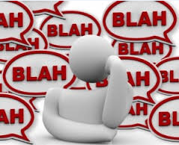
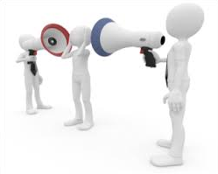
01. Information Overload
Large amount of information coming at you,so it’s easy to become overwhelmed.
It includes being on the phone to one person and talking to other person also at the same time.

Slide 47


02. Personal Concerns
It refers to when someone is absorbed in his/her own thoughts and concerns, they can’t focus on what the person is saying.
This leads you to become a less effective listener

Slide 48
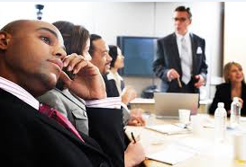
03. Outside Distraction
It refers to being easily distracted by outside world.
Fiddling with your hairs,fingers,classroom door slam are all included in this.

Slide 49

04. Prejudice
Sometimes you might have a hard time listening because you do not agree with the speaker.If you disagree with speaker then you might allow personal prejudices to distract you.

Slide 50

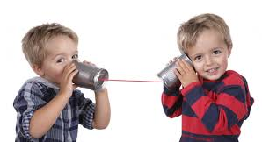
05. Rate Of Speech & Thought
Most people speak at a rate of 125 words per minute. As a listener you are able to filter 700 words a minute. If we can process so many more words than we actually hear, a mental lag can occur. Eventually you’ll stop listening or you’ll find yourself drifting in and out.

Slide 51
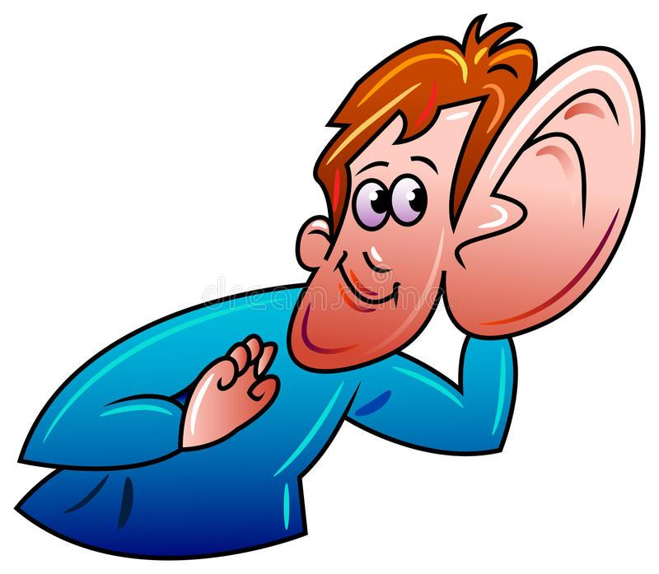
05.
Ways to improve listening SKills
ALI ZIA KHAN SE-19052

Slide 52

HOW TO DO THAT??
BUT!!!!

Slide 53

HERE IS THE SOLUTION
01
02
03
04
MAINTAINING EYE CONTACT
KEEP AN OPEN MIND
BE FOCUSSED
AVOID DISTRACTIONS
RESPOND APPROPRIATELY

Slide 54

Maintaining Eye Contact with the Speaker:
Having good eye contact with the speaker truly serves to be exceptionally important factor while listening.
It makes the speaker feels that you are not pretending but actually listening to him or her.

Slide 55
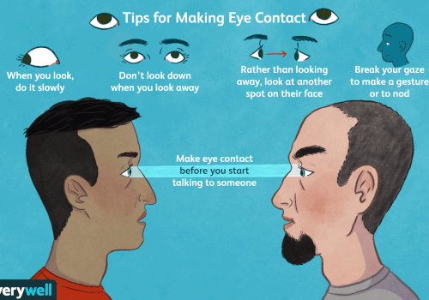

Difference Between Staring And Eye Contact :
Looking, while tuning in to the speaker is eye contact as both listener and speaker are mindful of being portion of handle of communication. On contrary, looking persistently at someone without any purpose comes beneath eye gazing.

Slide 56

Focus On What You Are Listening !

Slide 57

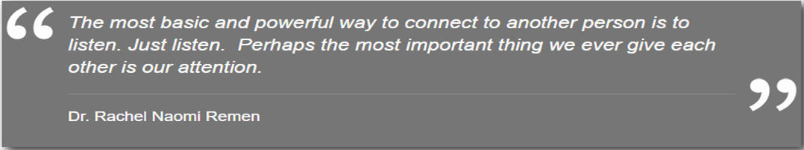
Concentrate on every bit of what speaker is saying.
Factually,receiving and then interpreting exactly what speaker means to say is in direct proportion to your focussed listening.
Be there,not only physically but mentally as well.
Heighten your concentration.

Slide 58

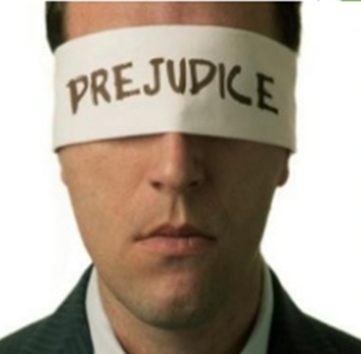
Be open minded:
Stay positive,never try to have
judgemental listening.
Keeping your mind free of preconceived notions let us allow to smell all perspective of what the speaker is conveying to us.
Try to be flexible, even if you agree or not.

Slide 59
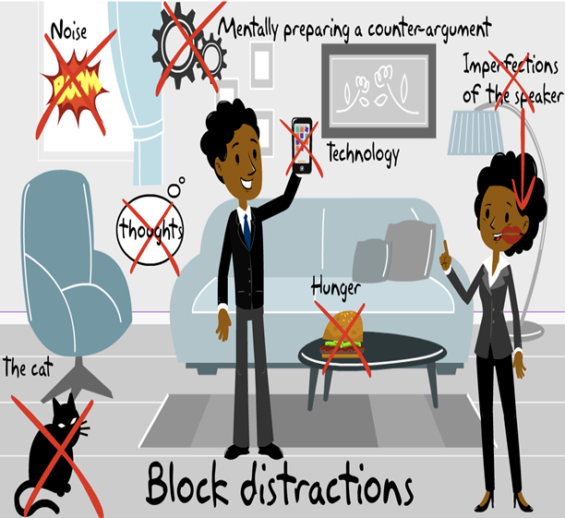
Avoid All Distraction:
Distractions refers to unnecessary disturbance or disruptions during listening.
CATEGORIZED AS:
INTERNAL DISTRACTIONS
EXTERNAL DISTRACTIONS

Slide 60
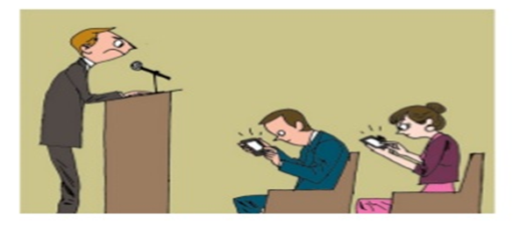

Resist all sort of distractions while listening.
They can be in the auditory or visual form like noise disruptions from outside, T.V, mobile phones or lightning etc.
Try to opt for a quiet time and place for listening.
·If you get indulge with disruptions while listening then it will clearly be asserted to speaker that you are turning deaf ears to what he or she is saying listening.·

Slide 61

Not to respond only,respond appropriately:
Response demonstrates to be very vital as it delineates to the speaker that listener is understanding the message.
It can also serve as feedback.
It adds actions to the process.
Always be honest and respectful while responding.
Response ought to be given suitably,but make sure,after listening carefully.

Slide 62

Points to care about while responding:
Not to make interruptions while speaker is saying.
Don’t try to be sentence grabber.
Be relax.
·Never jump to conclusions by yourself.
Do not try to be dominant over speaker while listening.
Ask questions if necessary only once the speaker completes his point.

Slide 63
CREDITS
ALI ZIA KHAN SE-052
FARIYA KHAN SE-066
NIMRAH ALTAF ADAM SE-077
RIDA KALIM SE-079
FASIH-UR-REHMAN ANSARI SE-090

Slide 64
REFERENCES
https://www.verywellmind.com/types-of-nonverbal-communication-2795397
Essentials of Business communication 8th edition by Mary Ellen Guffey
https://courses.lumenlearning.com/atd-fscj-publicspeaking/chapter/types-of-listening/
https://courses.lumenlearning.com/atd-fscj-publicspeaking/chapter/types-of-listening/
https://corporatefinanceinstitute.com/resources/careers/soft-skills/improve-your-listening-skills/

Slide 65
THANK YOU !!!
THE END OF OUR PRESENTATION

